Slide 1
Lecture 4 Mobile Patterns
KH6002CEM Mobile App Development
“The most basic way to get someone's attention is this: Break a pattern.”
~ Chip Heath and Dan Heath, Made to Stick: Why Some Ideas Survive and Others Die
Eng: Amir Tarek
Model Leader School of Computing

Slide 2
Lecture Outline
Functional and Non-functional Requirements.
UML.
Design Patterns.
Architectural Pattern.

Slide 3
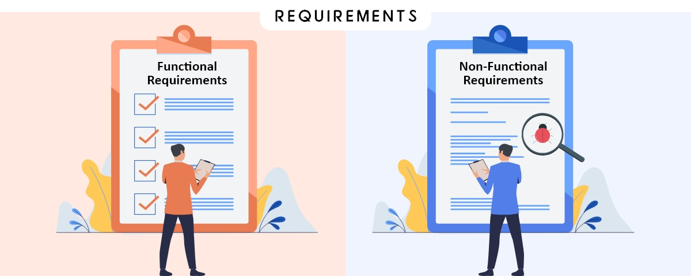
Functional and Non-functional Requirements
Who came first the chicken or the egg?

Slide 4
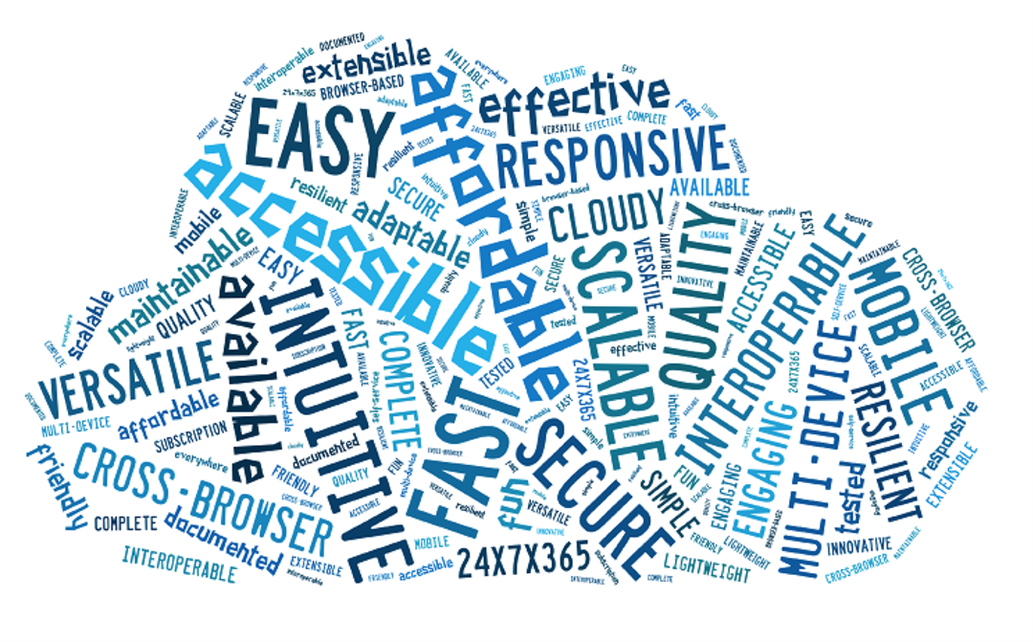
Functional and Non-functional Requirements: What are they? ->
Functional requirements define what a product must do, what its features and functions are.
Nonfunctional requirements describe the general properties of a system. They are also known as quality attributes.

Slide 5
Functional and Non-functional Requirements: Functional requirements->
Functional requirements are product features or functions that developers must implement to enable users to accomplish their tasks. So, it’s important to make them clear both for the development team and the stakeholders. Generally, functional requirements describe system behavior under specific conditions. For example:
The system sends an approval request after the user enters personal information.
A search feature allows a user to hunt among various invoices if they want to credit an issued invoice.
The system sends a confirmation email when a new user account is created.

Slide 6
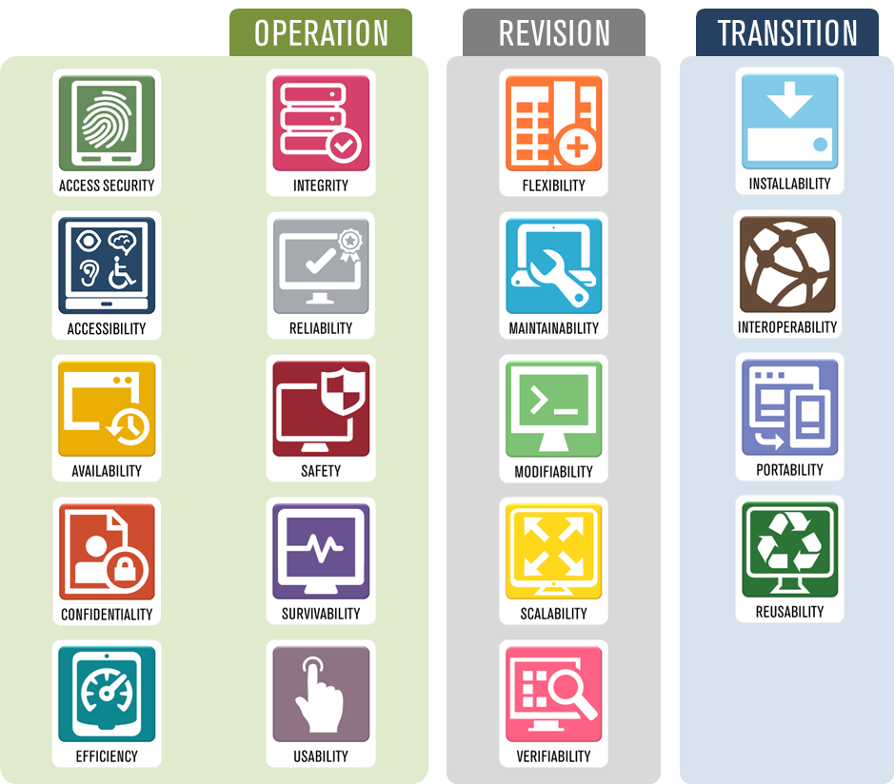
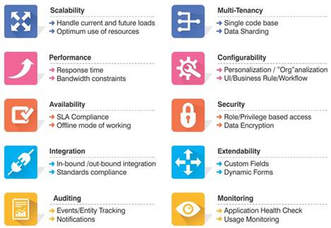
Functional and Non-functional Requirements: Non-Functional requirements checklist->

Slide 7
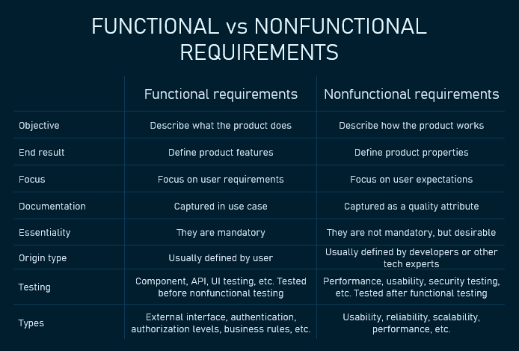
Functional and Non-functional Requirements:

Slide 8
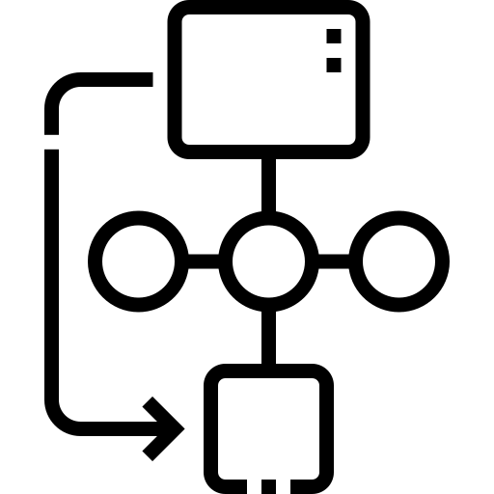
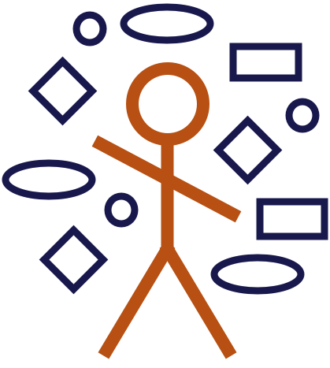
UML
Art is a way of survival

Slide 9
UML: What is UML? ->
UML, short for Unified Modeling Language,
is a standardized modeling language consisting of an integrated set of diagrams, developed to help system and software developers for specifying, visualizing, constructing, and documenting the artifacts of software systems, as well as for business modeling and other non-software systems.

Slide 10
UML: Why UML? ->
The primary goals in the design of the UML as follows:
Provide users with a ready-to-use, expressive visual modeling language so they can develop and exchange meaningful models.
Provide extensibility and specialization mechanisms to extend the core concepts.
Be independent of programming languages and development processes.
Provide a formal basis for understanding the modeling language.
Encourage the growth of the OO tools market.
Support higher-level development concepts such as collaborations, frameworks, patterns and components.
Integrate best practices.

Slide 11
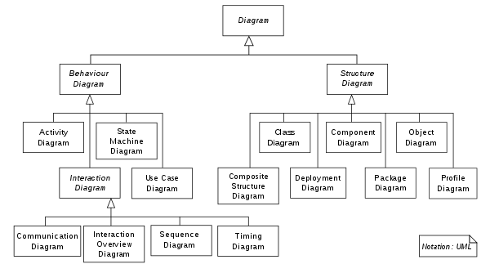
UML: UML Types ->

Slide 12
UML: Use Case ->
A use case diagram is used to represent the dynamic behavior of a system.
It encapsulates the system's functionality by incorporating use cases, actors, and their relationships.
It models the tasks, services, and functions required by a system/subsystem of an application.
It depicts the high-level functionality of a system and tells how the user handles a system.

Slide 13
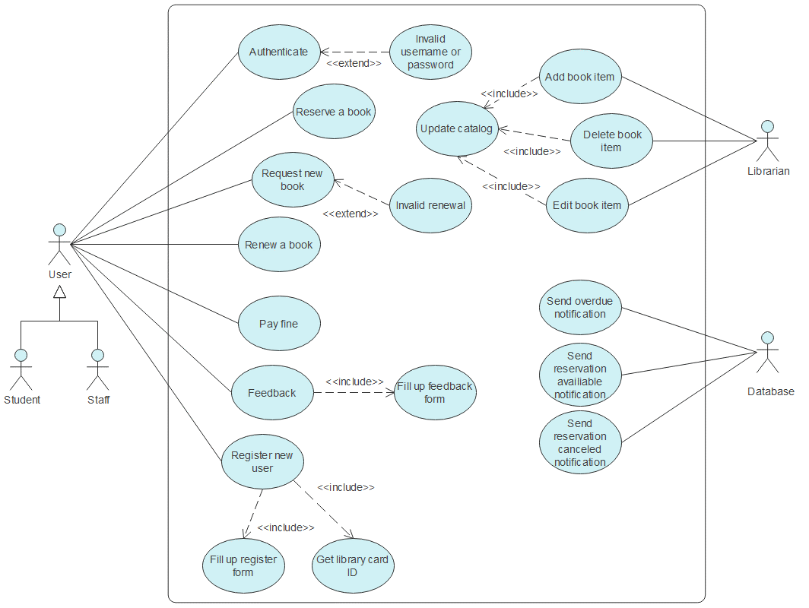
UML: Use Case Example ->

Slide 14
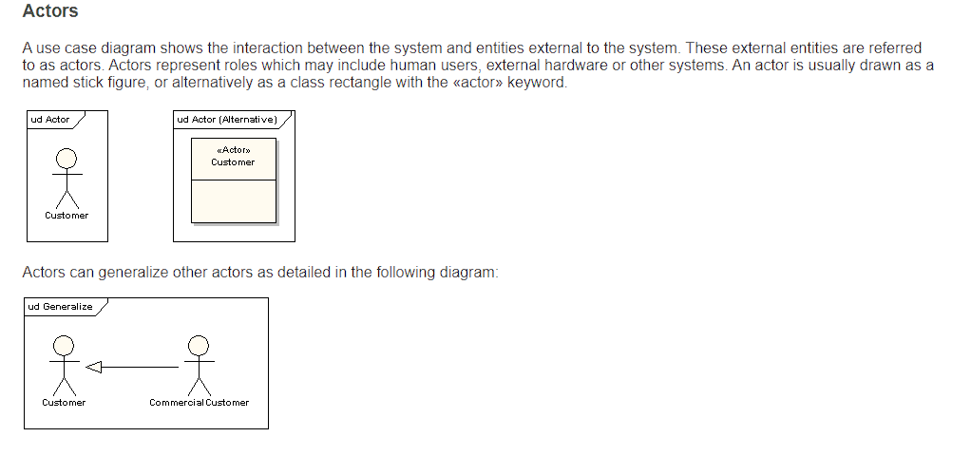
UML: Use Case Notation ->

Slide 15
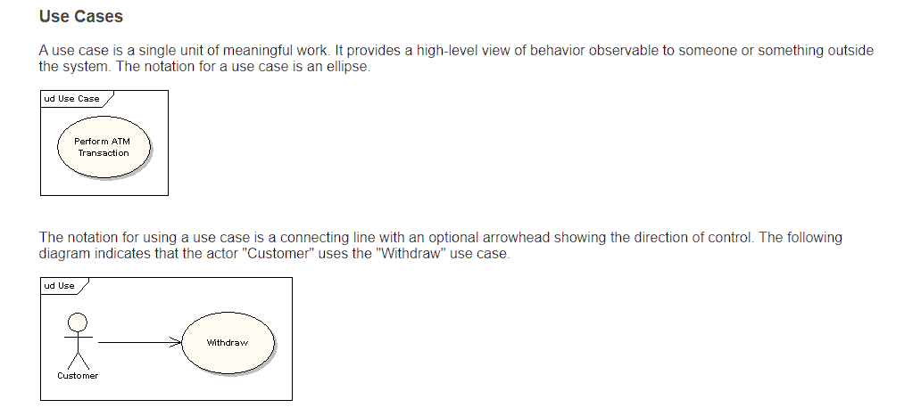
UML: Use Case Notation ->

Slide 16
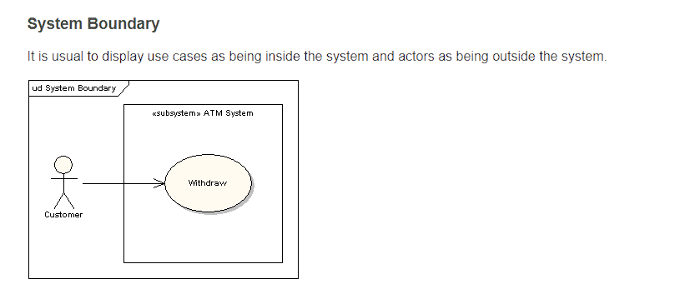
UML: Use Case Notation ->

Slide 17
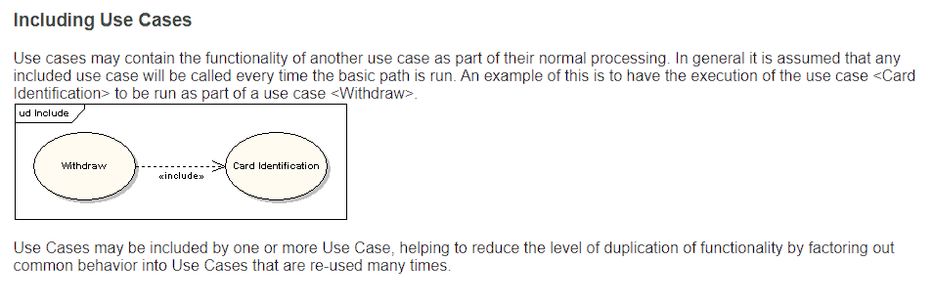
UML: Use Case Notation ->

Slide 18
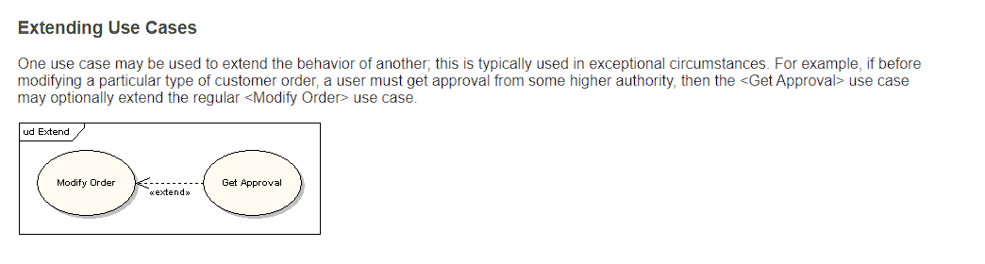
UML: Use Case Notation ->

Slide 19
UML: Use Case Quiz ->
Airport Check-In and Security Screening
Business actors are Passenger, Tour Guide, Minor (Child), Passenger with Special Needs (e.g., with disabilities), all playing external roles in relation to airport business.
Business use cases are Individual Check-In (could be a counter or kiosk) , Group Check-In (for groups of tourists), Security Screening, etc. - representing business functions or processes taking place in airport and serving the needs of passengers.
Business use cases Baggage Check-in and Baggage Handling extend Check-In use cases, because passenger might have no luggage, so baggage check-in and handling are optional.

Slide 20
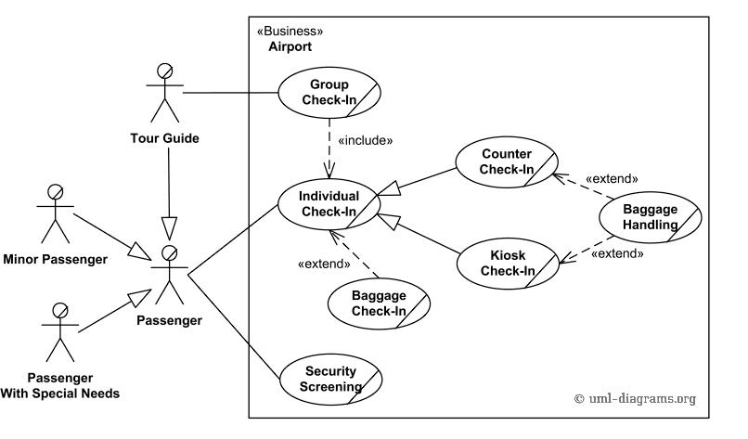
UML: Use Case Quiz ->

Slide 21
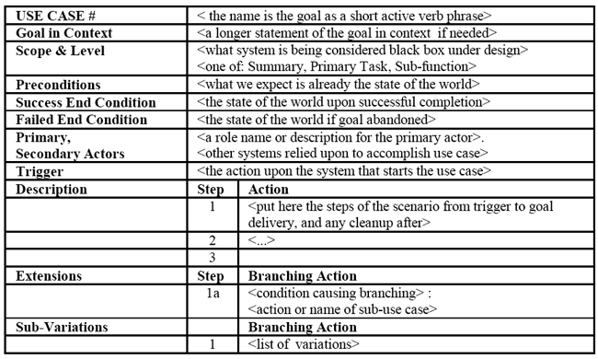
UML: Use Case Scenario ->

Slide 22
UML: Activity Diagram->
Activity diagrams are graphical representations of workflows of stepwise activities and actions with support for choice, iteration and concurrency.
It describes the flow of control of the target system, such as the exploring complex business rules and operations, describing the use case also the business process.
In the Unified Modeling Language, activity diagrams are intended to model both computational and organizational processes (i.e., workflows).

Slide 23
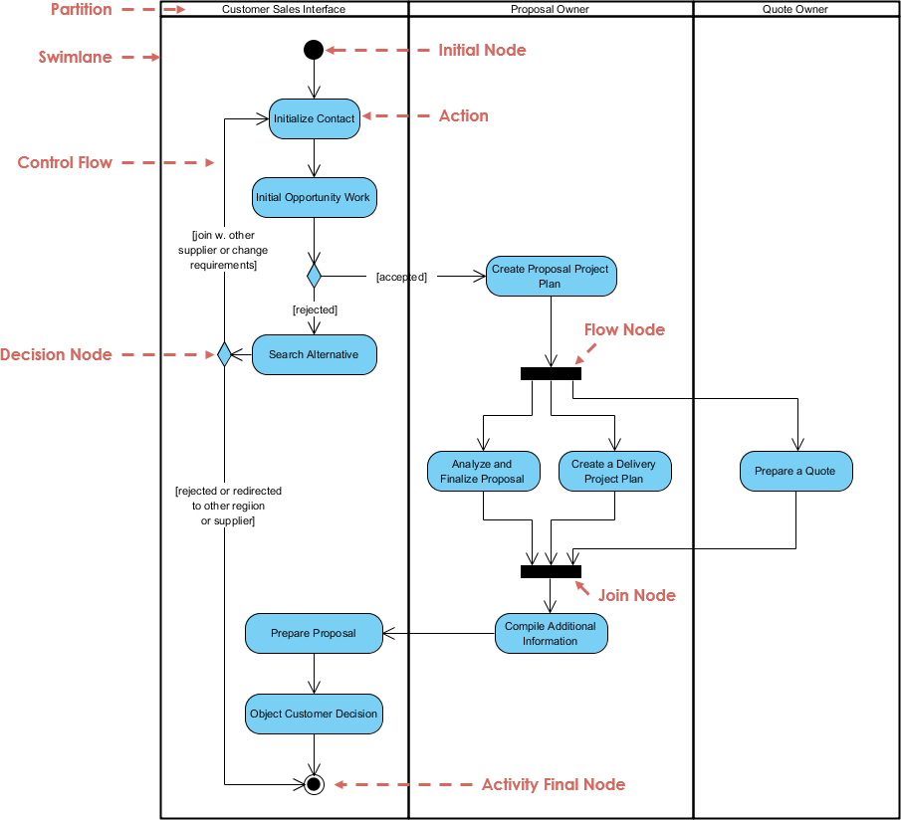
UML: Activity Diagram Example ->

Slide 24
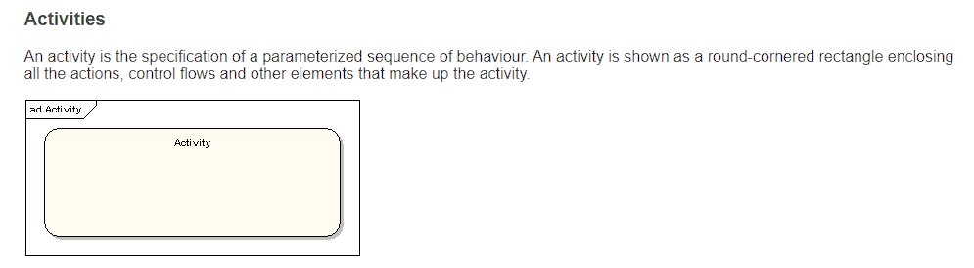
UML: Activity Diagram Notations->

Slide 25
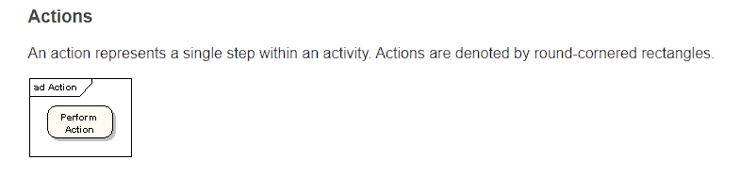
UML: Activity Diagram Notations->

Slide 26
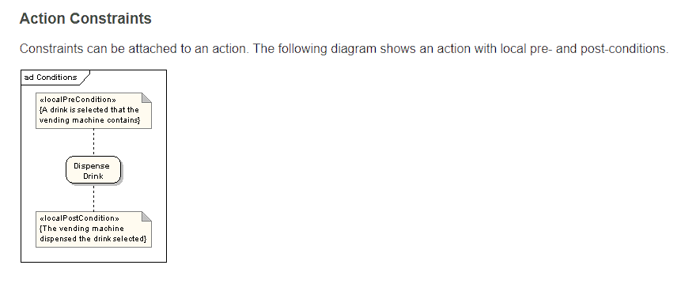
UML: Activity Diagram Notations->

Slide 27
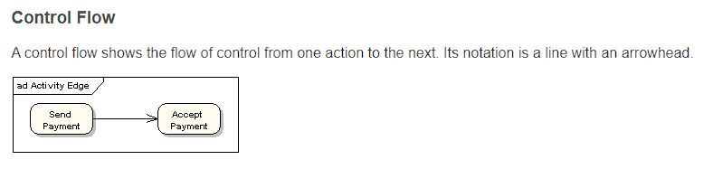
UML: Activity Diagram Notations->

Slide 28
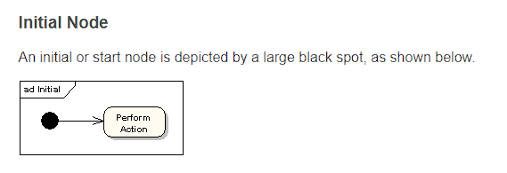
UML: Activity Diagram Notations->

Slide 29
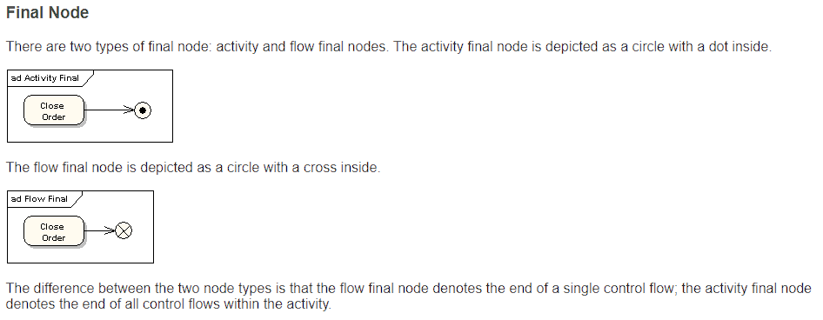
UML: Activity Diagram Notations->

Slide 30
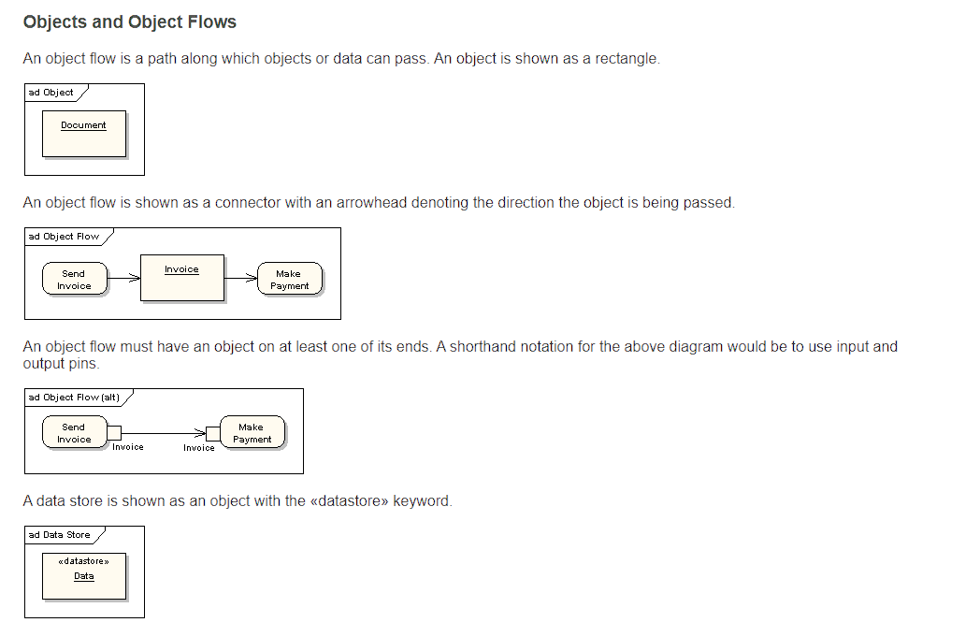
UML: Activity Diagram Notations->

Slide 31
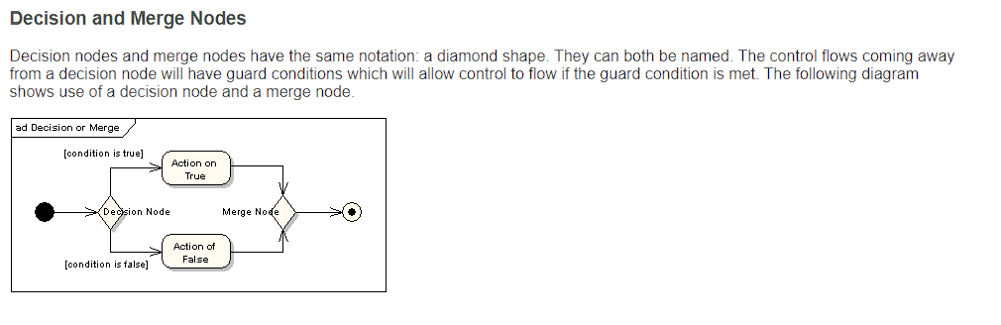
UML: Activity Diagram Notations->

Slide 32
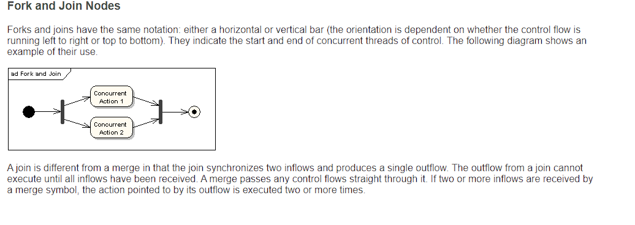
UML: Activity Diagram Notations->

Slide 33
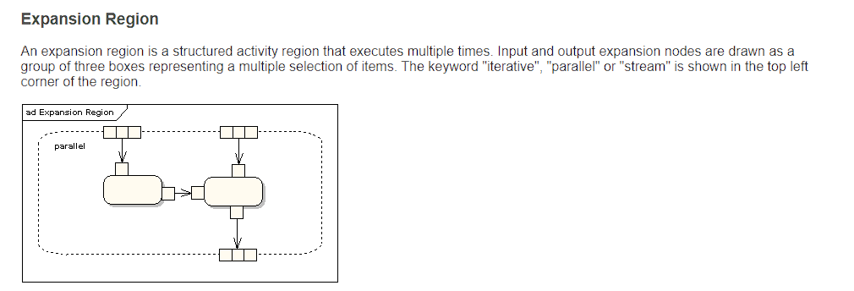
UML: Activity Diagram Notations->

Slide 34
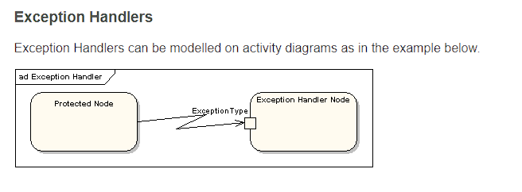
UML: Activity Diagram Notations->

Slide 35
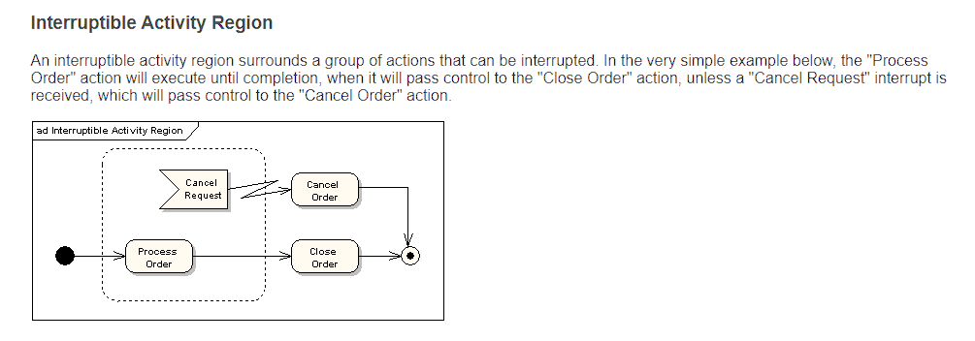
UML: Activity Diagram Notations->

Slide 36
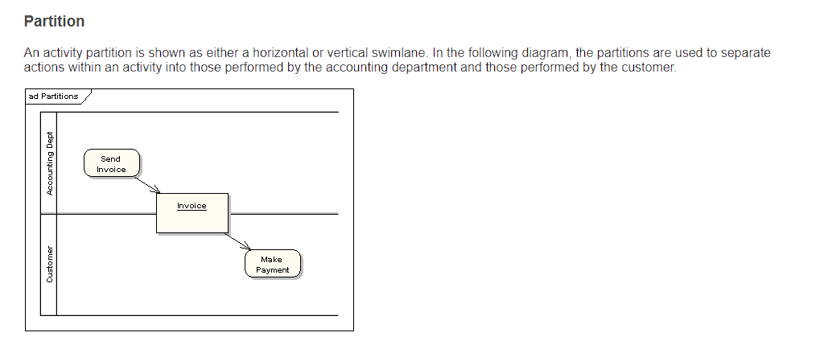
UML: Activity Diagram Notations->

Slide 37
UML: Activity Diagram Quiz ->
An example of activity diagram for online shopping. Online customer can browse or search items, view specific item, add it to shopping cart, view and update shopping cart, checkout. User can view shopping cart at any time. Checkout is assumed to include user registration and login.
This example does not use partitions, most of the actions are assumed to be fulfilled by online customer.

Slide 38
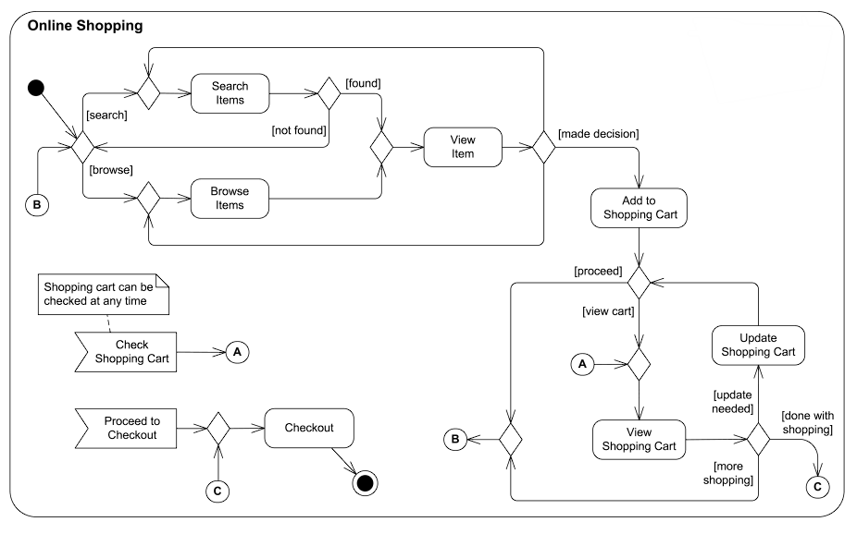
UML: Activity Diagram Quiz ->

Slide 39
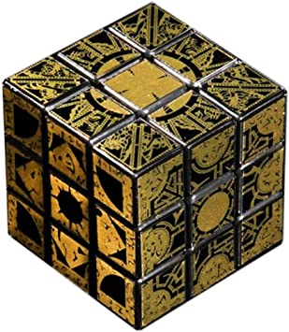
Design Patterns
Naming a pattern immediately

Slide 40
Design Patterns: What is Design Patterns? ->
Design patterns are typical solutions to commonly occurring problems in software design. They are like pre-made blueprints that you can customize to solve a recurring design problem in your code.
You can’t just find a pattern and copy it into your program, the way you can with off-the-shelf functions or libraries. The pattern is not a specific piece of code, but a general concept for solving a particular problem. You can follow the pattern details and implement a solution that suits the realities of your own program.

Slide 41
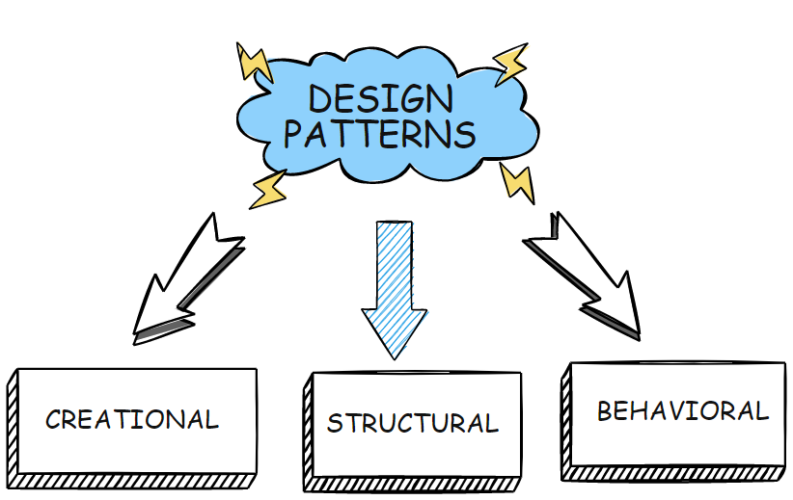
Design Patterns: Design Types ->
All patterns can be categorized by their intent, or purpose. There are the three main groups of patterns:
Creational patterns provide object creation mechanisms that increase flexibility and reuse of existing code.
Structural patterns explain how to assemble objects and classes into larger structures, while keeping these structures flexible and efficient.
Behavioral patterns take care of effective communication and the assignment of responsibilities between objects.

Slide 42
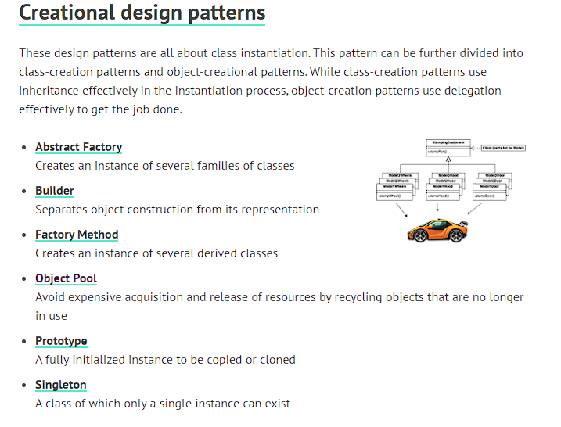
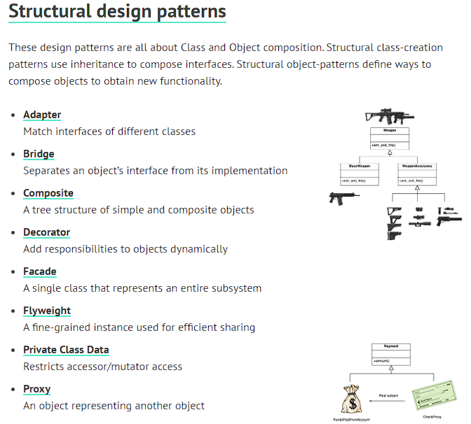
Design Patterns: Design Types ->

Slide 43
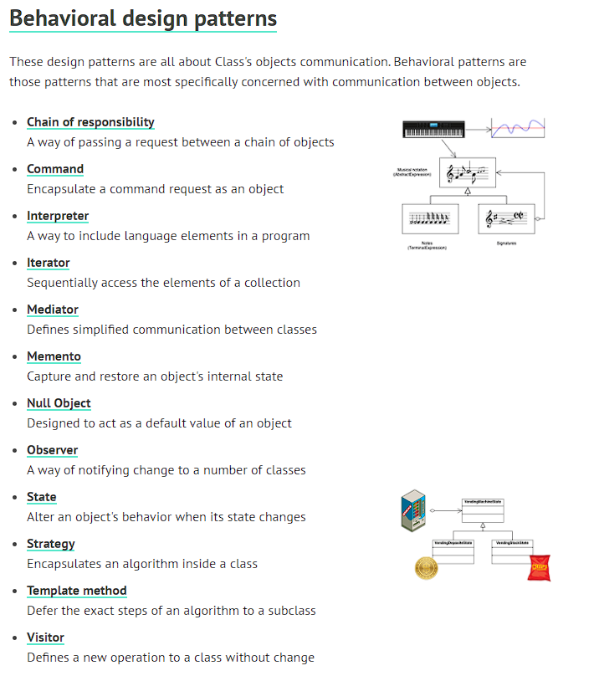
Design Patterns: Design Types ->

Slide 44
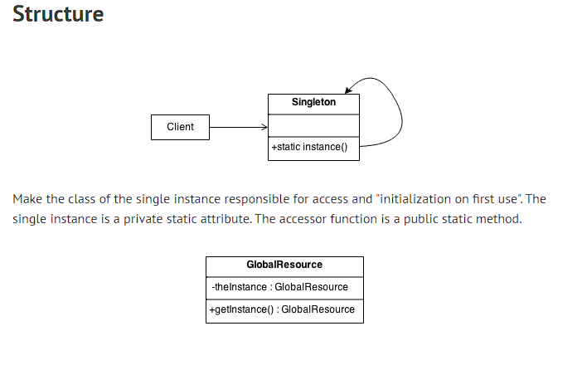
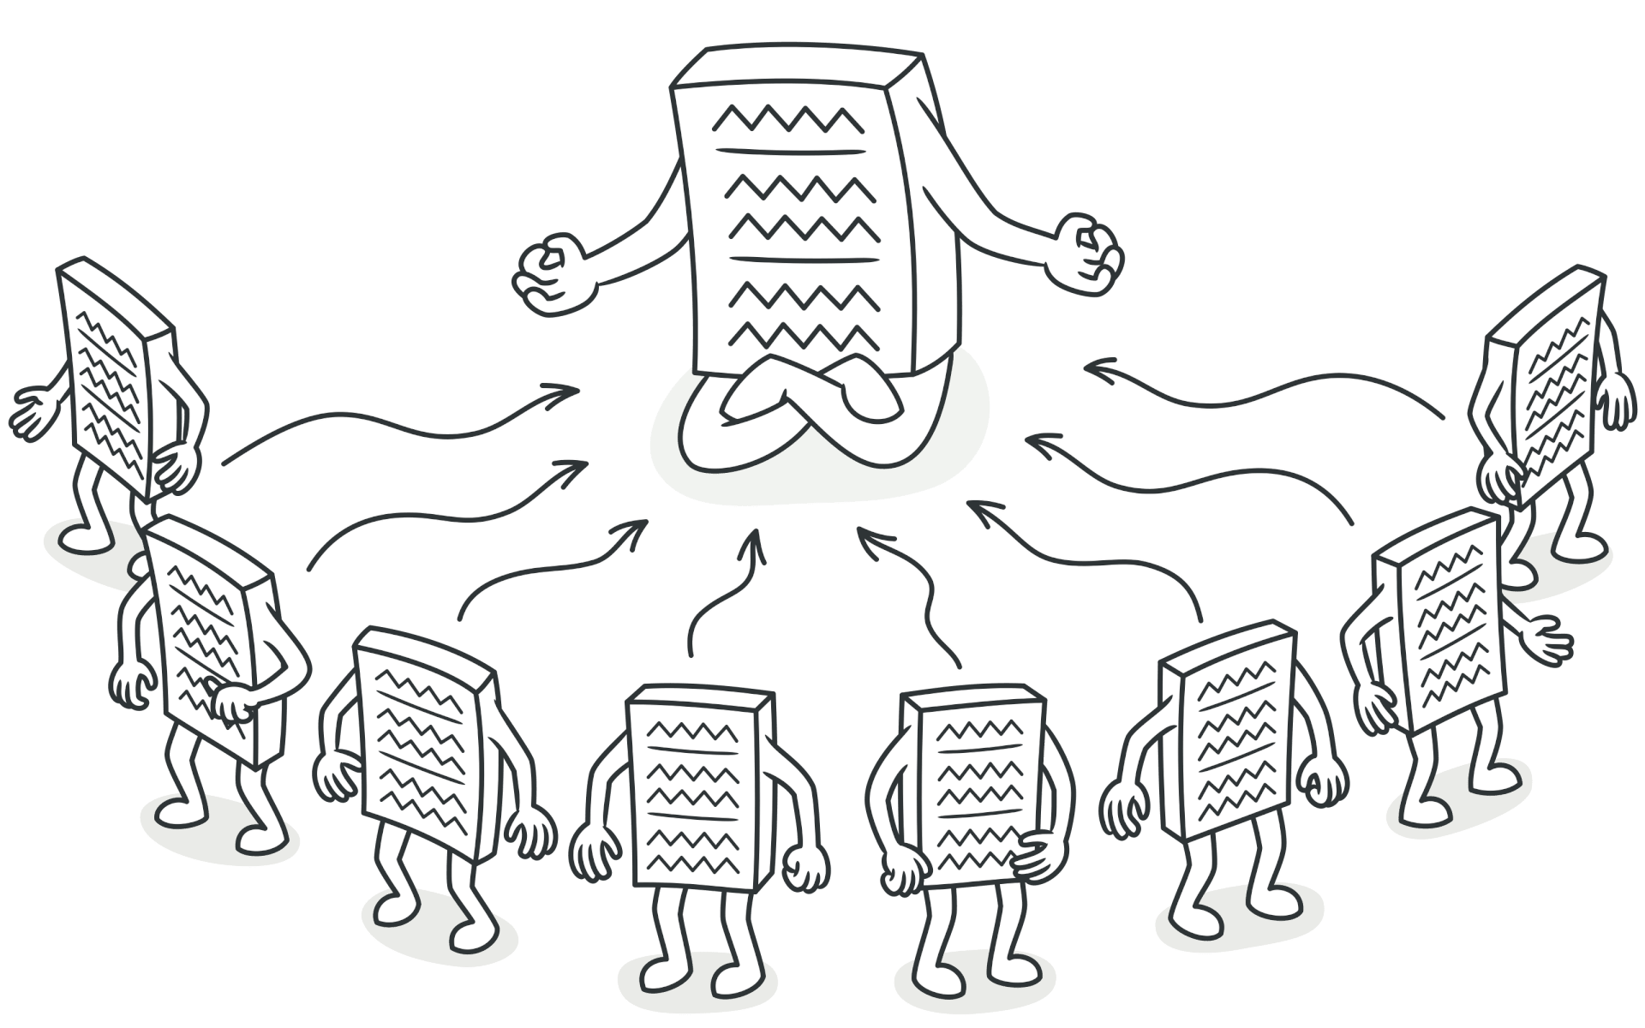
Design Patterns: Singleton Design Pattern ->
Problem:
Application needs one, and only one, instance of an object. Additionally, lazy initialization and global access are necessary.

Slide 45
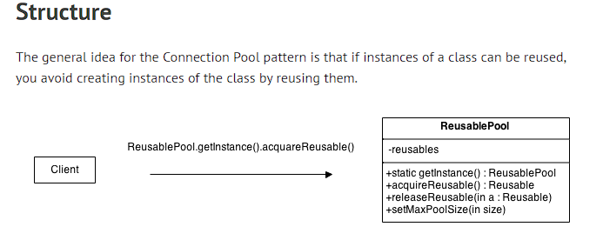
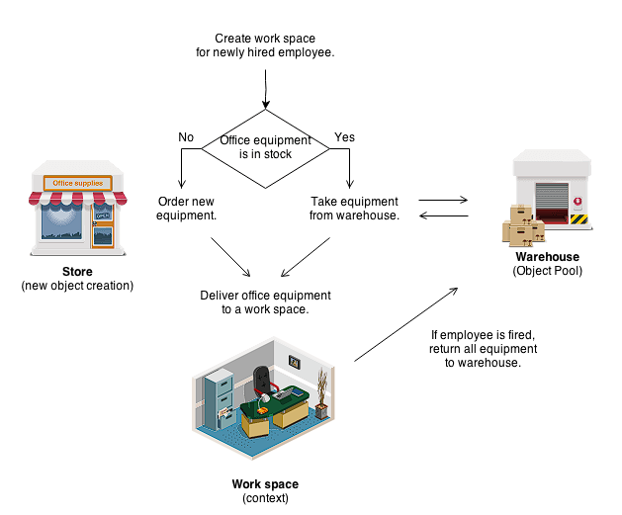
Design Patterns: Singleton Design Pattern ->
Problem:
A client with access to an Object pool can avoid creating a new Objects by simply asking the pool for one that has already been instantiated instead. Generally, the pool will be a growing pool, i.e. the pool itself will create new objects if the pool is empty, or we can have a pool, which restricts the number of objects created.
It is desirable to keep all Reusable objects that are not currently in use in the same object pool so that they can be managed by one coherent policy. To achieve this, the Reusable Pool class is designed to be a singleton class.

Slide 46
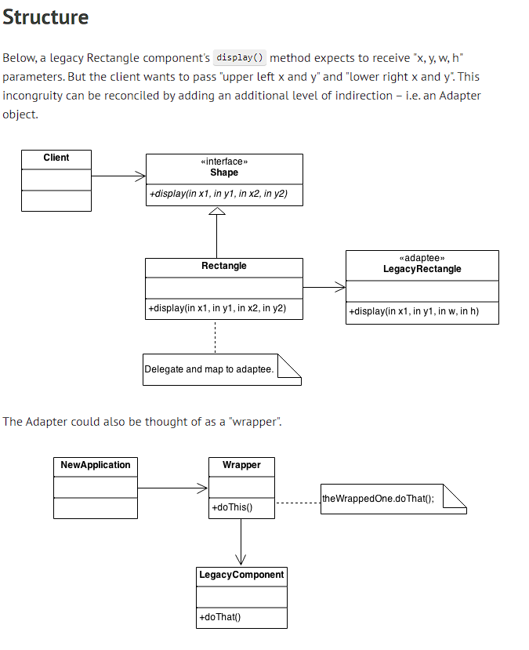
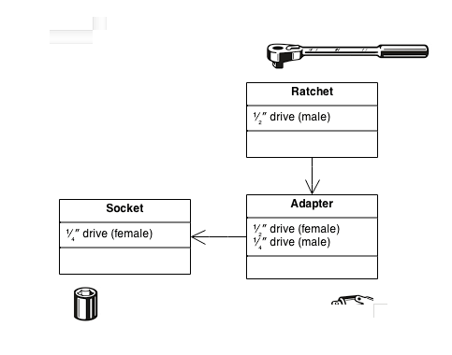
Design Patterns: Adapter Design Pattern ->
Problem:
An "off the shelf" component offers compelling functionality that you would like to reuse, but its "view of the world" is not compatible with the philosophy and architecture of the system currently being developed.

Slide 47
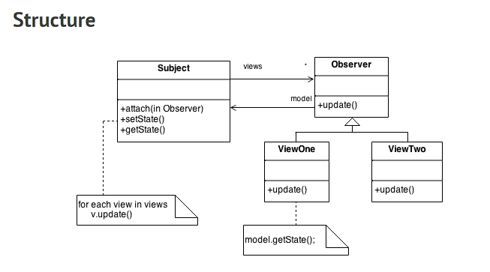
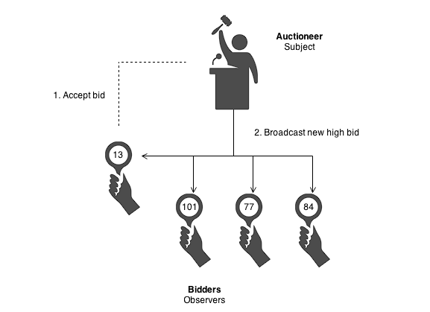
Design Patterns: Observer Design Pattern ->
Problem:
A large monolithic design does not scale well as new graphing or monitoring requirements are levied.

Slide 48
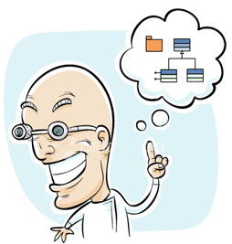
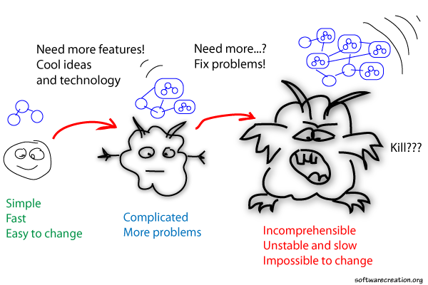
Architectural Pattern
A design isn't finished until someone is using it

Slide 49
Architectural Pattern: What Is Mobile App Architecture ->
Mobile architecture is a body of rules, techniques, and patterns on how to develop a mobile application. This set allows building logical and well-structured apps that meet customers’ requirements and industry standards. Let’s have a closer look at how it works.
There are many aspects that influence the development of a good mobile architecture such as the type of mobile platform, type of device, speed of internet connection, potential mobile gadget characteristics – load on CPU, screen size, resolution, and many others.
Before starting building an app right away, a team of experts should define customer’s requirements and decompose them into small logical chunks for mobile developers to code.
Once the team gets the idea of what features they need to build in the app, they prepare the app architecture – a skeleton that binds these features together into one app. An app’s productivity, scalability, user-friendliness, and other factors depend on how thoroughly the development architecture is thought-out.

Slide 50
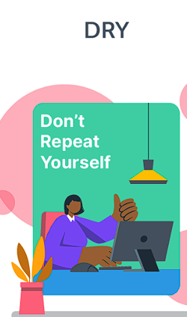
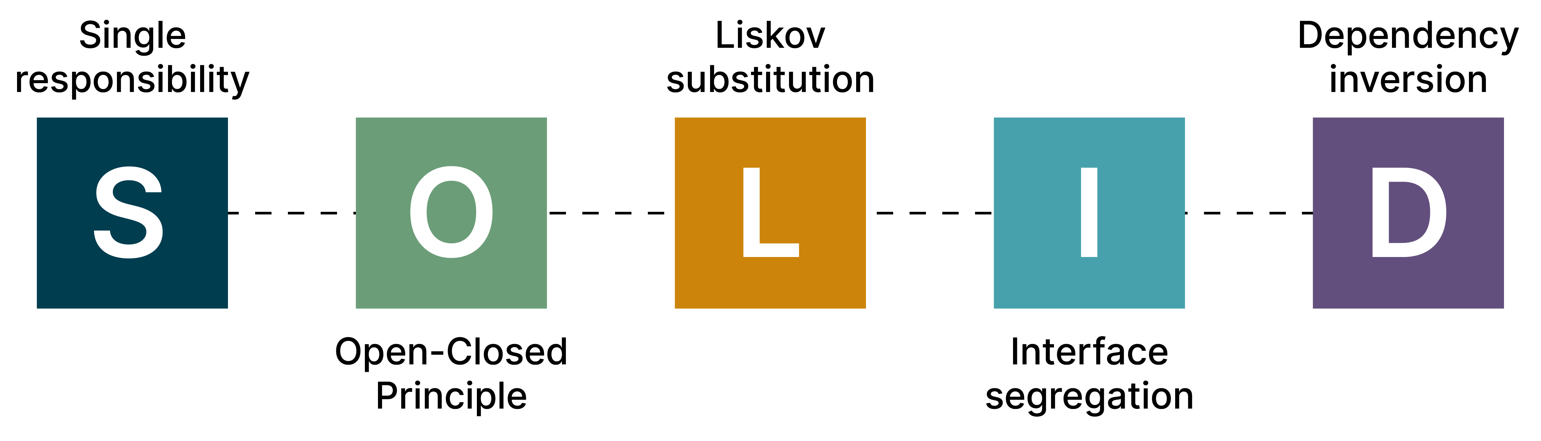
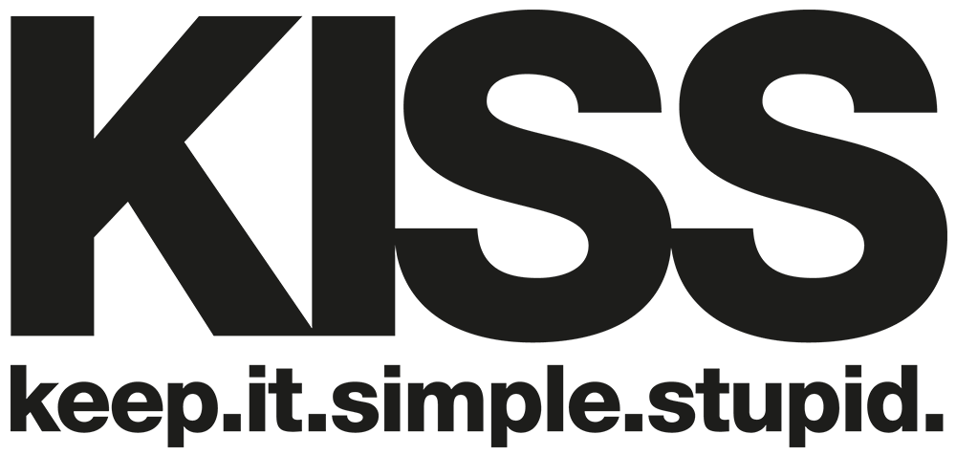
Architectural Pattern: What Makes a Good Mobile App Architecture ->

Slide 51
Architectural Pattern: The Difference Between Architectural and Design Pattern->
Let's start with the common term—pattern. In software, a pattern is a recurrent property that lets you break down a huge and complex structure into smaller, simpler components. You can use this pattern to craft a general solution for a class of problems.
In each level of software development, you’ll use different tools. At smaller levels, these tools are design patterns. Architectural patterns exist at larger levels, and programming paradigms at the implementation level.

Slide 52
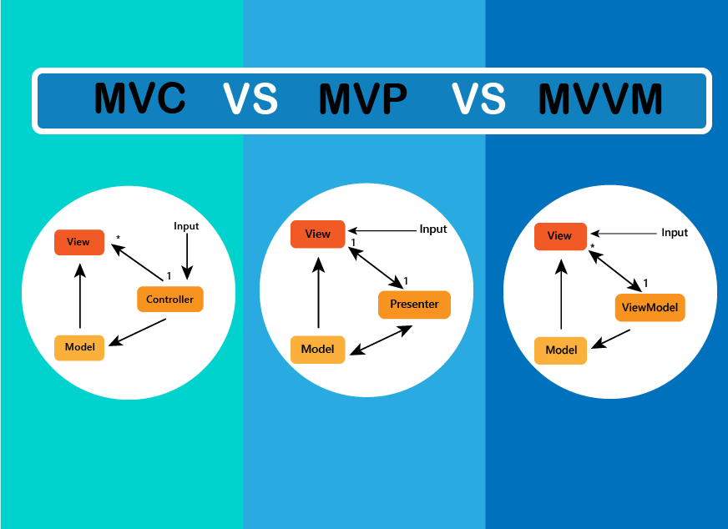

Architectural Pattern: The three most popular architectural patterns ->

Slide 53

Architectural Pattern: MVC->
This pattern lets you build an application around Separation of Concerns (SoC). It eases the effort you need to test, maintain, and develop your application.
In the MVC pattern, the model has no understanding of the view or the controller. The model's observer will receive an alert whenever there's a change in the view and controller. The controller helps the routing process to connect the model to the relevant view.
Some of the MVC pattern's advantages are:
Separation of concerns (more focused).
Makes it easier to test and manage the code.
Promotes decoupling of the application's layers.
Better code organization and reusability.
When to Use MVC:
MVC is simply an implementation of Separation of Concerns. If your application needs to separate the data (model), the data crunching (controller), and data presentation (view), MVC will work well.
MVC also serves well in an application where the data source and/or the data presentation can change at any time.

Slide 54

Architectural Pattern: MVC->
The MVP pattern shares two components with MVC: model and view. It replaces the controller with the presenter.
The presenter is used to present something.
It allows you to mock the view more easily.
In MVP, the presenter has the functionality of the "middle-man" because all presentation logic is pushed to it.
The view and presenter in MVP are also independent of one another and interact via an interface.
When to Use MVP:
You can use MVP when your application has a bidirectional flow. If user interactions need to request something from the model, and the result of this request will change the UI immediately, consider MVP.

Slide 55

Architectural Pattern: MVC->
MVVM is the modern evolution of MVC. The main goal of MVVM is to provide a clear separation between the domain logic and presentation layer.
MVVM supports two-way data binding between the view and viewmodel.
The MVVM pattern allows you to separate your code’s view and model.
This means that when the model changes the view doesn’t need to, and vice-versa.
Using a viewmodel, you can do unit testing and test your logic behavior without involving your view.
When to Use MVVP:
You need to share a project with a designer and the design and development work can happen independently.
You require unit testing for your solutions.
You need to have reusable components, both within and across projects in your organization.
You want more flexibility to change your views without having to refactor other logic in the code base

